Slide 1
IMAGE PROCESSING
WEEK-1

Slide 2
INTRODUCTION TO IMAGES AND FORMATS

Slide 3
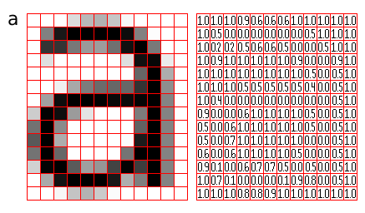
What is an image?
Definition:
An image is a numerical matrix(a grid of numbers) that represents the intensity or color of each point(pixel) in the picture.
In simple terms:
An image is an mosaic of tiny dots called pixels.Each pixel is a building block containing color and intensity information,which together create the complete picture.
Why image is important in computer vision?
Computer vision uses images to:
Detect objects
Recognize faces
Classify images(eg. Dogs vs. cats)
Track movements
Read text(OCR)
Understand scenes(autonomous cars)

Slide 4
Types of digital images-
Raster images(Bitmap images)-
These images are made up of of pixels(tiny dots of colors).
Characteristics:
Lose quality when zoomed in
Store color values for every pixel
Very common in AI and ML
Examples:
Photos from phones
Screenshots
Computer vision datasets(CiFAR-10,MNIST,ImageNet)
Common raster formats:
JPEG
PNG
GIF
TIFF
BMP

Slide 5
b. Vector images-
These images are made of mathematical curves and shapes(not pixels).
Characteristics:
Doesn’t lose quality when zoomed in
Great for printing and resizing
Not used in computer vision tasks.
Examples:
Logos
Icons
Illustrations
SVG graphics
Common vector formats:
SVG
AI
EPS
PDF

Slide 6
In computer vision,raster images are classified into:
Binary images: Only two color: black-(0) and white-(1)
Used in- Thresholding, Mask processing, OCR(optical character recognition)
Grayscale images: Only shades of gray(0-255)
Used in- Edge detection, Medical imaging , Classical computer vision(Canny,etc)
Color images(RGB images): Three channels: Red, Green, Blue
Used in- Object detection, Classification, Segmentation
Multispectral images: More than three channels(eg. 7-15 channels)
Used in- Satellite imaging, Agriculture, Environment monitoring
Hyperspectral images: Hundreds of channels(100-200+ channels)
Used in- Minerals analysis, Medical diagnosis, Scientific imaging
3D images: contain depth information in addition to 2D pixels
Used in- CT scans, MRI scans, VR,AR furnitures(eg;ikea), e-commerce virtual(lensk)

Slide 7
Image formats:
JPEG/JPG(Joint Photographic Experts Group):
It is an raster image format
Why? :
Small size images
Is good quality for natural images
Use cases:
Photos(camera,phones)
Social media images
Web photos
Machine learning dataset(CIFAR)

Slide 8
PNG(Portable network graphics)-
It is an raster image format.
Why? :
High quality
No loss of details
Transparent backgrounds
Use cases:
Logos
Icons
Web graphics needing transparency
Screenshots

Slide 9
GIF(Graphics interchange format):
It is an raster image format
Why? :
Lightweight animations
Use cases:
Short animations
Memes
Simple graphics with few colors
BMP(Bitmap image file):
It is an raster image format.
Why? :
Pure pixels data,no loss
Use cases:
Raw image data
Image processing experiments
Medical imaging

Slide 10
TIFF(Tagged image file format):
It is an raster image format.
Why? :
Very high quality images
Can store multiple layers and channels
Use cases:
High-quality photography
Medical imaging(X-ray,MRI)
Satellite images
Document scanning
Printing industry
WEBP(Web picture format):
It is an raster image format
Why? :
Better compression than JPG and PNG
Google recommends it for web performance

Slide 11
Use cases:
- Modern websites
- Performance-optimized web graphics
- Replacing JPG/PNG
HEIF/HEIC(High efficiency image format):
It is an raster image
Why?:
Superior compression and quality
Supports depth maps
Use cases:
Iphone and high-end cameras
Storing high-quality photos with small file size

Slide 12
RAW image formats(CR2,NEF,ARW,DNG):
It is an raster image formats.
Why?:
Maximum details
Best for editing or ML processing
Use cases:
Professional photography
Image processing
Computer vision research
SVG(Scalable vector graphics):
It is an vector image format.
Why?:
Infinite scalability
Very small size
Use cases:
Logos,icons,diagrams,illustrations
Wen and UI designs

Slide 13
EPS(Encapsulated postscript):
It is an vector image format.
Use cases:
Print media
High-resolution graphics
Professional logos
PDF(Portable document format):
It is an hybrid image format(vector+raster)
Use cases:
- Documents with images
- Print-ready designs
- Multi-page graphics
HDR/EXR(High dynamic range images):
It is an raster image format
Use cases:
Visual effects, lightweight environments
Gaming,scientific imaging

Slide 14
Color spaces-
Color Spaces is a specific organisation of colors that helps in the representation and reproduction of digital images.
Types of color spaces are-
RGB - Red green Blue- it combines the three colors in various ways to produce hues.
HSV - Hue, saturation and value - which represents the color in terms of the shade,vibrancy and brightness.
Grayscale image- it strips away color to focus on shades of grey highlighting texture and contrast.
BGR(Blue green red)- this is an additive color spaces, it is an color model that stores pixel values in the order:[BLUE,GREEN,RED],this format is used in opencv2
CMYK(Cyan-magenta-Yellow-key(Black))- this subtractive color model is used for printing.this is used in printing presses,packaging,high quality color prints.Key is the volume of black

Slide 15
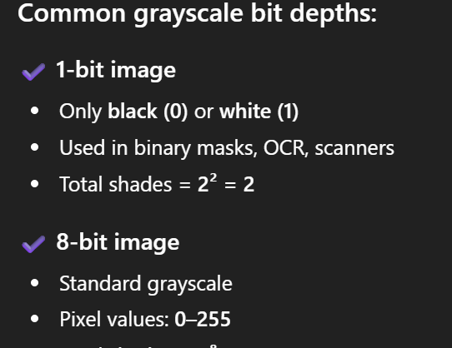
BIT Depth:
Bit depth refers to the number of bits used to represents the color(intensity) of each pixels
More bits=more colors and shades
Less bits=less colors or shades
BIT depth in grayscale image:

Slide 16
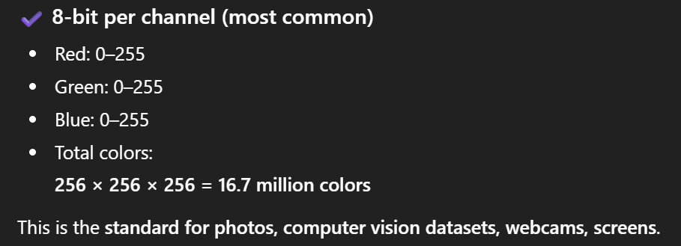
Bit depth in color images(RGB):
Have 3 channels(R,G,B)
Used in:
Raw camera images
HDR imaging
High-end sensors
Professional color grading

Slide 17
EXIF:
EXIF standards for -Exchable image file format
It is a standard that stores extra information inside image files images like JPEG,TIFF,Raw
This metadata includes:
Camera settings
Date and time
Gps location
Image processing
Device information
Where it is used?:
Computer vision
Forensics
Map and location apps
- Formats that does not support EXIF
- PNG
- GIF
- BMP

Slide 18
codes:
Hands on - https://colab.research.google.com/drive/1ov7DY8HomVY3fu8MiS-R-nXRQ17CbpjR#scrollTo=9fwq4qfzKiPU
POC -
Show how the same ML model (e.g., ResNet) performs differently on:
JPEG (low quality)
PNG (high quality)
WEBP (compressed)
https://colab.research.google.com/drive/1FKHTct1V13nu0KFRR8ajkXBdGP9_U4Ce#scrollTo=oLPZbxd9M5Xw

